Slide 1
Quickly Build a Predictive Chatbot With
IBM Cloud
Watson Machine Learning
Watson Conversation
Sam Ennis
Client Technical Solutions Specialist
Analytics Platform Cloud Offerings
Sam.Ennis@ibm.com
October 2017

Slide 2
The real value of data is being able to extract meaningful insight, to make more informed decisions, and to create differentiating, predictive business models.

Slide 3
Build on the cognitive platform for business
IBM Cloud enables you to integrate powerful analytics and AI into your applications.

Slide 4
Demo Scenario – Building a Predictive Chatbot
Fitness Club USA is a national gym chain
They want to get their members to sign up for more fitness classes (cross-sell opportunity) by offerings personalized recommendations
They want to enhance customer experience by providing a personalized interface for customers across multiple channels of interaction

Slide 5
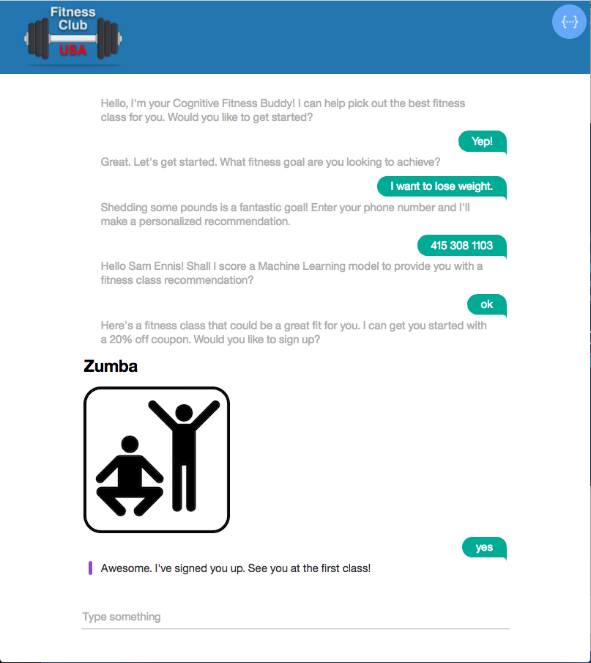
Fitness Club USA’s new cognitive website…

Slide 6
IBM Cloud Services used to build Fitness Club USA’s app
Flow-based programming on Node.js runtime
HTTP (REST)
HTTP (REST)
Data Science Experience
Watson Machine Learning
Watson Conversation
Create ML models using a variety of tools and frameworks (Python, Spark, SPSS)
Deploy ML models to RESTful endpoint for scoring
Continuous monitoring and feedback of ML models in production
API to build a chat bot from the ground up to be used across multiple channels
Understands natural-language and responds to customers in human-like conversation
Integrated dialog builder to easily construct dialog flows
Node-RED
HTTP (REST)
Cloudant

Slide 7
IBM Cloud Catalog
Find these services and more in the…
https://console.bluemix.net/catalog/

Slide 8
Demo Overview – Building a Predictive Chatbot
RESTful Web Service
Customer Data
Data Science Experience
Fitness Class Recommendation Model
Watson Machine Learning
RESTful Web Service
Watson Conversation
Trained Chatbot
Node-RED
Web Application

Slide 9
Step #1 – Create & Deploy ML Model
RESTful Web Service
Customer Data
Data Science Experience
Fitness Class Recommendation Model
Watson Machine Learning

Slide 10
Step #2 – Train Chatbot
RESTful Web Service
Customer Data
Data Science Experience
Fitness Class Recommendation Model
Watson Machine Learning
RESTful Web Service
Watson Conversation
Trained Chatbot

Slide 11
Step #3 – Put it together with Node-RED
RESTful Web Service
Customer Data
Data Science Experience
Fitness Class Recommendation Model
Watson Machine Learning
RESTful Web Service
Watson Conversation
Trained Chatbot
Node-RED
Web Application

Slide 12
Bonus Step – Augment With Additional Services
RESTful Web Service
Watson Tone Analyzer
Customer Data
Twilio (3rd Party)
Data Science Experience
Fitness Class Recommendation Model
Watson Machine Learning
RESTful Web Service
Watson Conversation
Trained Chatbot
Node-RED
Web Application

Slide 13
http://ecc.ibm.com/case-study/us-en/ECCF-WUC12544USEN

Slide 14
Build on the cognitive platform for business
with IBM Cloud
Sam Ennis
sam.ennis@ibm.com
Client Technical Solutions Specialist
Analytics Platform Cloud Offerings
Sign up for IBM Cloud:
https://console.bluemix.net/registration/
Instructions to set up this app yourself:
https://github.com/samcennis/Watson-Conversation-ML-Demo

